Slide 1
Bike Sewa
Name: Ngima Sherpa (07)
Course/Semester: BCA sixth semester
Supervisor: Mr. Yub Raj Kalathoki
Date: 2079/02/10

Slide 2
Introduction
Web based application
The admin side and the user side are both included
User can login , update profile ,add/update bike, online booking, view old servicing record through online
Admin can do CRUD operation on customer/bike/mechanic, and can view total customers, bikes, accepted booking, mechanic.

Slide 3
Existing Problem
Customer can’t book online for servicing
Customer can’t view old servicing details
Customers have to wait in the queue

Slide 4
Objectives
The main objective of this project is as following.
To book servicing through online
To view old servicing records
To get feedback from customers to analyze the company services from the customer point of view
To Provide better services to customer

Slide 5
Limitation
Online payment is not present
The customer has to book for service with a time slot

Slide 6
Tools and Technology
Frontend tools
  HTML5
  CSS3
  JavaScript v8
  jsp
Backend tools
  Java EE v8 (servlet )
  MySQL 8.0
Server
  Tomcat 8.5.
Others
  NetBeans 12.6
  Git and GitHub
Methodology
  Waterfall model

Slide 7
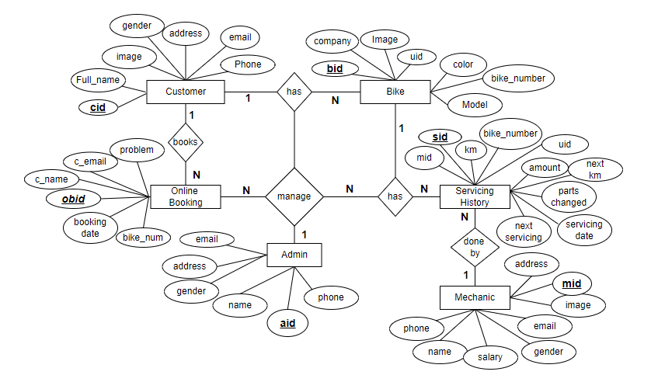
ER Diagram

Slide 8
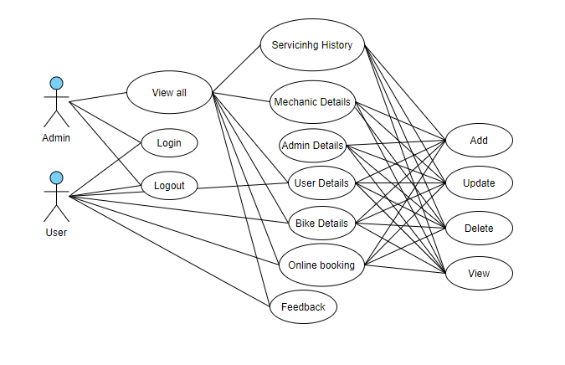
Use case Diagram

Slide 9
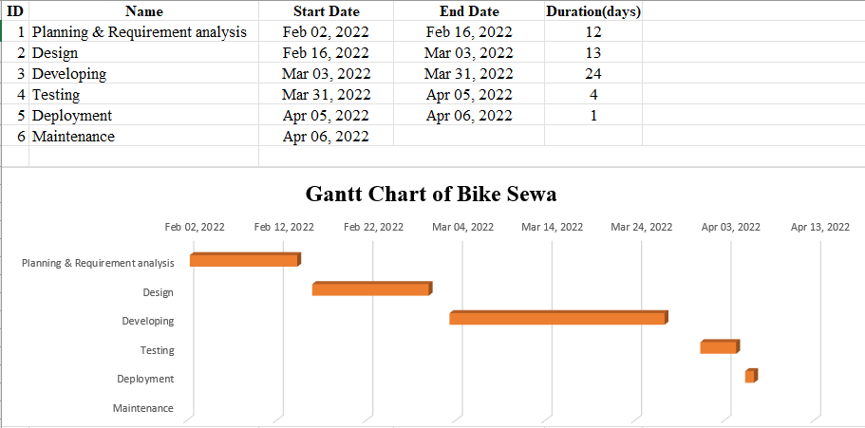
Project Timeline

Slide 10
Demo
http://localhost:9494/BikeSewa/

Slide 11
Conclusion
Everyone needs to get their Bike repaired or servicing. Making this process more convenient by providing online booking increases customer satisfaction and workshop efficiency

Slide 12
Any Questions ?

Slide 13

Thank You

